Slide 1
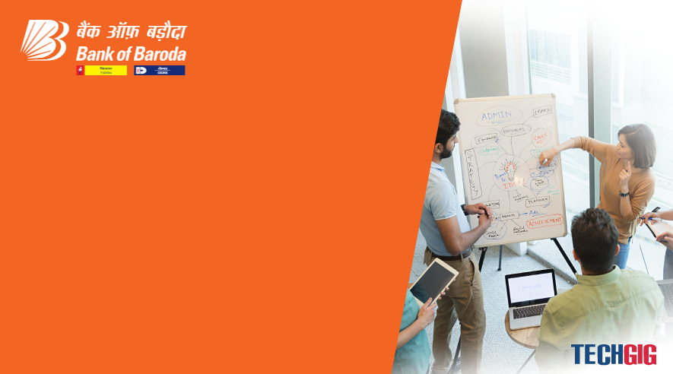

Bank of Baroda Hackathon - 2022
Technology Partner
Your Team Name : Team Check
Your team bio : Working for the betterment
Date : 20-09-2022

Slide 2
Problem Statement?
Why did we decide to solve this Problem statement?
We chose this problem statement , because it has a wide range deploying field.
Bank handles large volumes of cheques in the clearing process. The process involves many technical verifications including signature verification. Some of these steps are manual and require human intervention to complete the process. The current process requires a high human capital deployment and longer processing time.
So we decided to select this problem statement in order to create a prototype where we can process the checks online with ease without any manual work which is a tiring process.

Slide 3
User Segment & Pain Points
Which user /advertiser segment would be early adopter of your product & why?
Banking segment would be our early adopter and buissness people who have to send checks everyday and who recieve check in their daily day to day life, because in order to send or post a check in todays world we to go to the banks and sometimes wait in the queues to post check.
But with our model we do not need to go out of our house we can stay at house and post a check with just a laptop and a Internet connection

Slide 4
Pre-Requisite
What are the alternatives/competitive products for the problem you are solving?
Our alternatives/competitive products will be Gpay, PayPal etc. But in these other alternatives we can only do limited amount of money transfer.
But with our model, we can handle large amount of money transfers as we have included many steps of verification process, such as OTP, signature verification,

Slide 5
Azure tools or resources
Azure tools or resources which are likely to be used by you for the prototype, if your idea gets selected we would like to use Azure cloud service for uploading the model in the online platform, Azure database for storing data ,Azure cloud architect for creating the website that is to be presented to the user.

Slide 6
Any Supporting Functional Documents
Present your solution, talk about methodology, architecture & scalability
Basically our idea is to process the Cheque system automatically in the Internet platform , in a safest format with more security.
Our system is to get the input from the user i.e (signature) that is been verified by Machine learning Model.
The given input signature is been verified with the previously stored pre-processed Data.
The things that are to be verified from the user are:-
1.OTP that is been sent to the user.
2.Account number
3.Username
4.Signature
5.Password

Slide 7
Key Differentiators & Adoption Plan
How is your solution better than alternatives and how do you plan to build adoption?
Our solution is better than the alternatives because we have additional verification from the user, more secured way of giving the inputs , user friendly , easy processing.
Adoption Plan:
Used in Banking Sector for Hand’s Free cheque Processing , Saves lots of time for the user , help them to know about how the signature is being verified by the Bank .

Slide 8
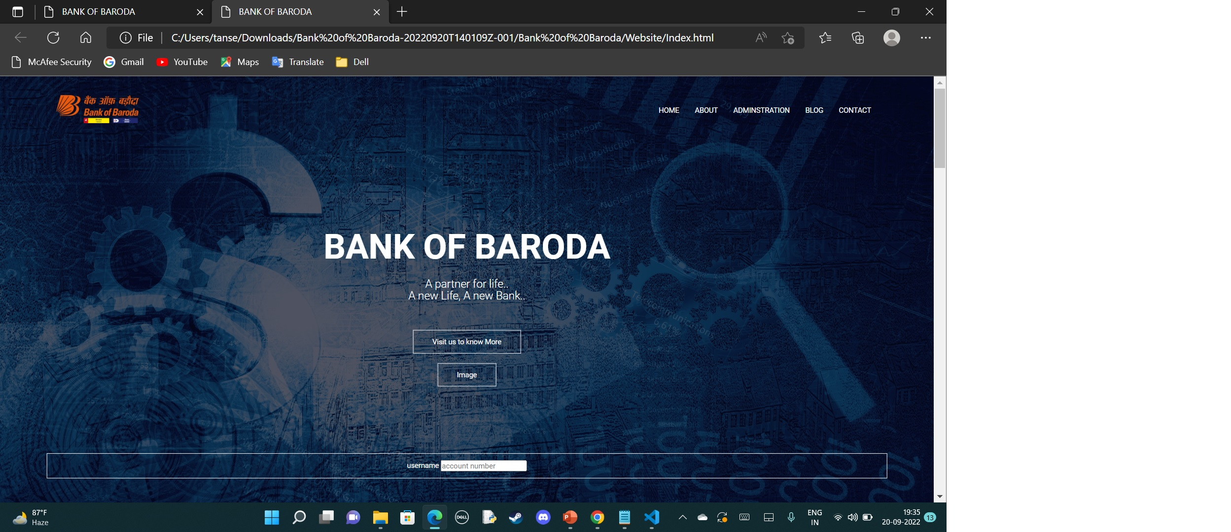
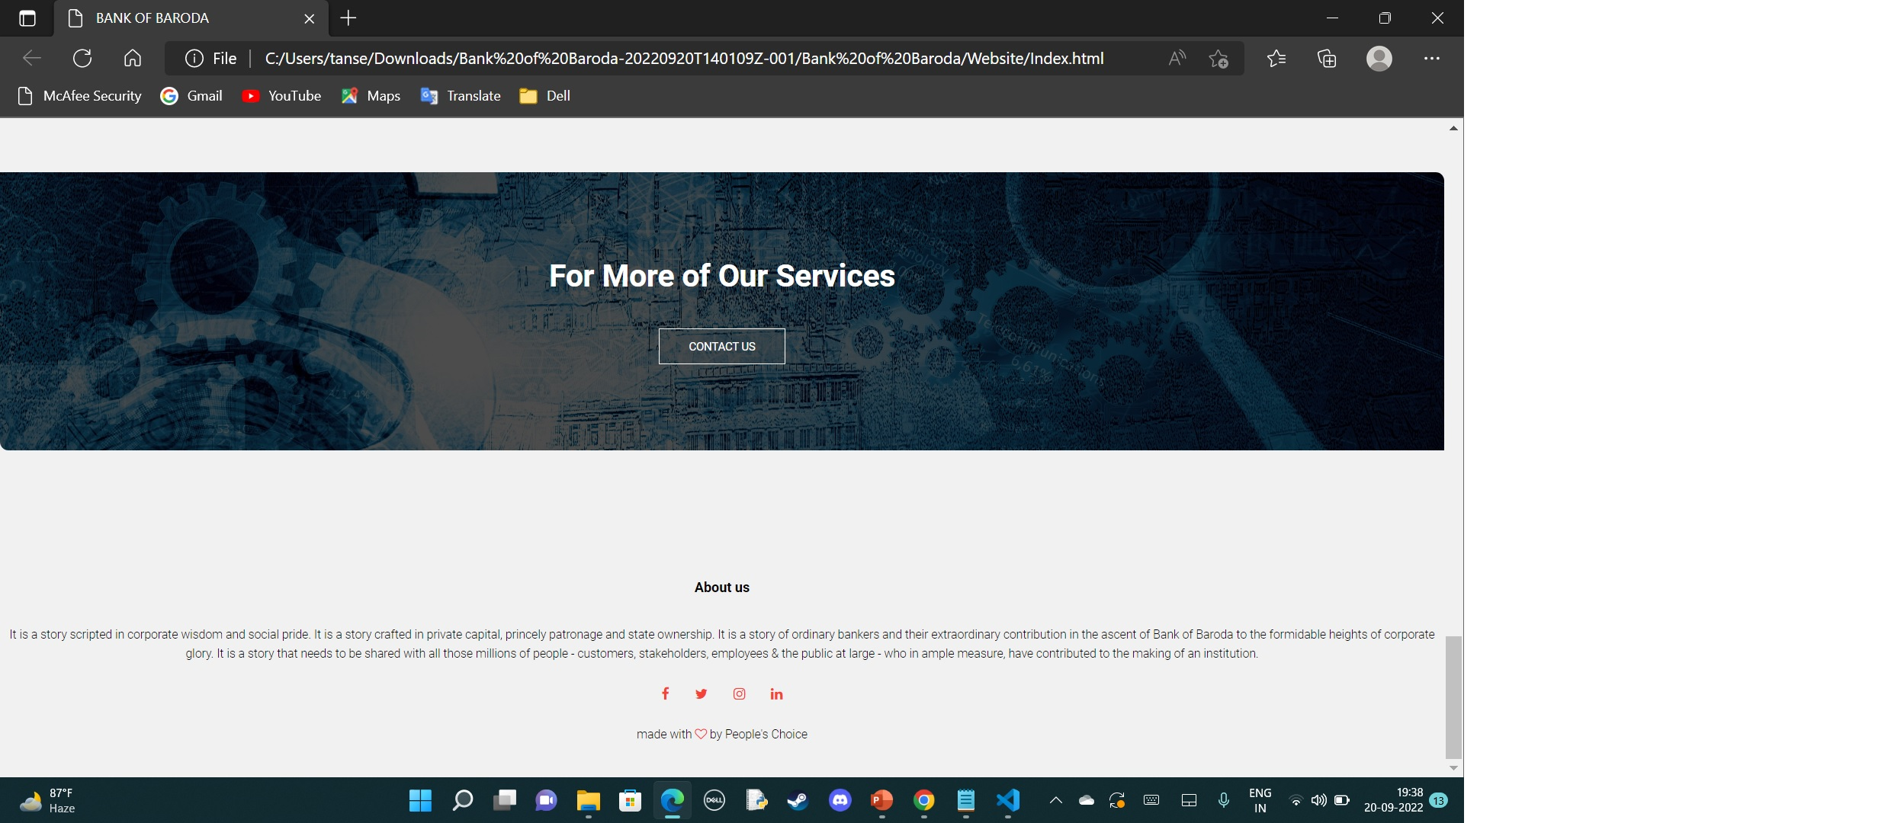
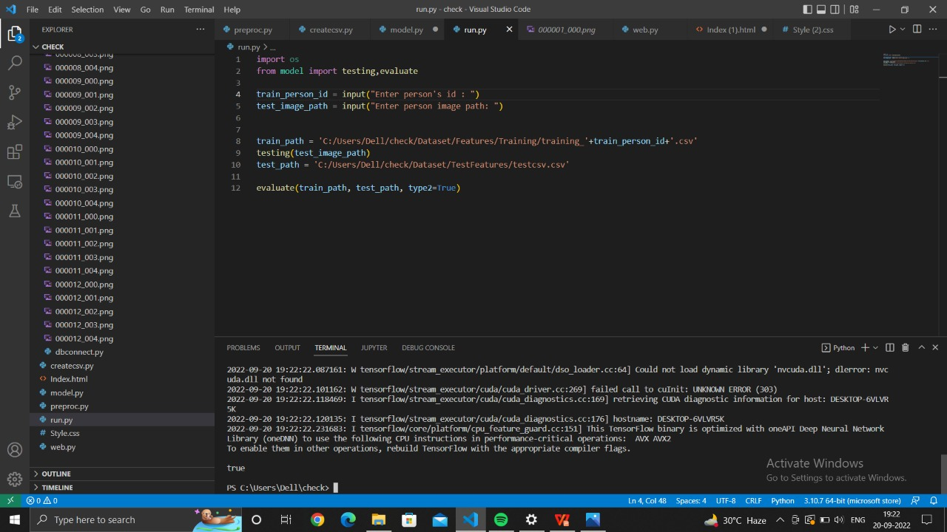
GitHub Repository Link & supporting diagrams, screenshots, if any
How far it can go?
https://github.com/Nithish271/check_processing

Slide 9
Thank You
Team member names: Nithish P
Raghul J
Mithun Nitheesh Rogan R
Lokesh A

